Slide 1
2. Robot Dynamics
2.1 Newton-Euler formulations
2.2 Lagrange-Euler formulation
2.3 Properties of Dynamic Models
2.4 Dynamics Tutorials
2.5 Neural Network Modelling

Slide 2
2.3 Properties of Dynamic Model
2.3.1 The Properties of Each Term in the Dynamic Model
The inertia matrix D(q) is
Symmetric : D^{T}=D
Positive Definite : Q = x^{T} D x>0, WHY?
( The Kinetic energy , so )
back to lecture note 2.2 Lagrangian Method p19
is Quadratic in
G(q) is a function of q only
There is an independent control input for each degree-of-freedom

Slide 3
2.3 Properties of Dynamic Model
5) Linear-in-the-parameters dynamics (LIPS dynamics)
All the constant parameters of interest, such as link masses, moments of inertia, etc, appear as coefficients of known functions of the generalized coordinates.
By defining coefficients as a parameter vector, we have
For example,

Slide 4
2.3 Properties of Dynamic Model
6) The matrix is skew-symmetric:
if , show that
Proof: Chain Rule
The kjth element of N is

Slide 5
2.3 Properties of Dynamic Model
The same procedure

Slide 6
2.3 Properties of Dynamic Model
2.3.2 Case Analysis (p.98, Fu, et al)
Joint variables:
Masses of links:
Link parameters:
θ₂
l
y₁
m₂
x₁
y₀
l
z₁
for revolute joint
C
θ₁
m₁
x₀
z₀
Knowing
back to lecture note 1. Review of Kinematics p14-16
and lecture note 2.2 Lagrangian Method p10

Slide 7
2.3 Properties of Dynamic Model
Suppose that
back to lecture note 2.2 Lagrangian Method p19

Slide 8
2.3 Properties of Dynamic Model
back to lecture note 2.2 Lagrangian Method p19

Slide 9
2.3 Properties of Dynamic Model
back to lecture note 2.2 Lagrangian Method p19

Slide 10
2.3 Properties of Dynamic Model
From
can be defined as:
Independent of

Slide 11
2.3 Properties of Dynamic Model

Slide 12
2.3 Properties of Dynamic Model
In matrix form
Note that in the text book

Slide 13
2.3 Properties of Dynamic Model
So we get the dynamic model
where

Slide 14
2.3 Properties of Dynamic Model
The Summary of Properties：
Let
Then, the motion equations become
Acceleration:
Velocity:

Slide 15
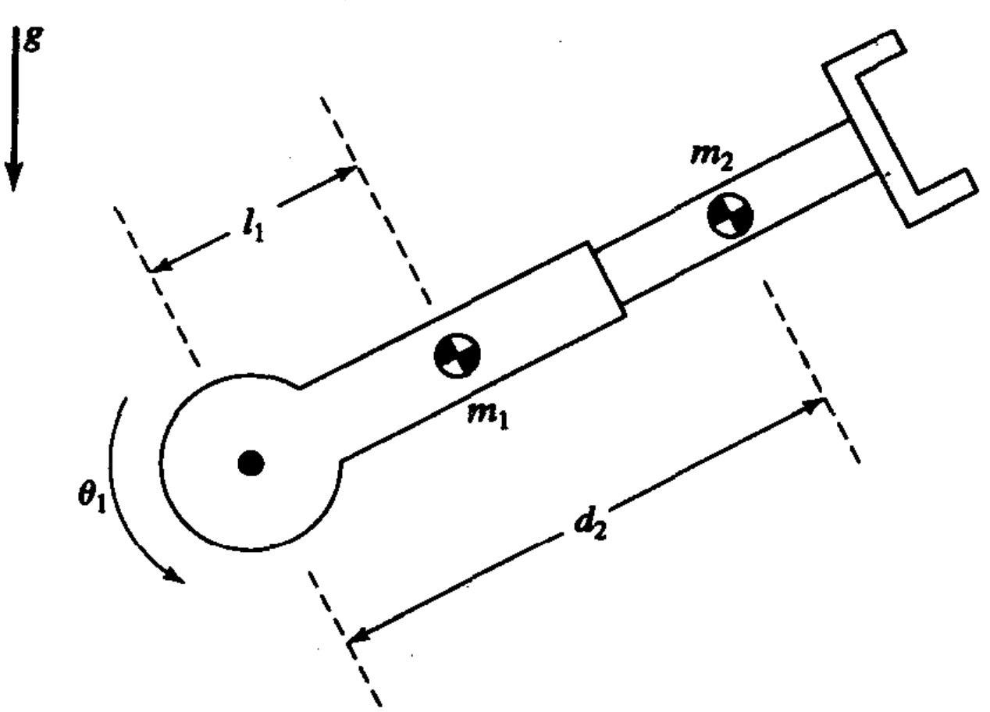
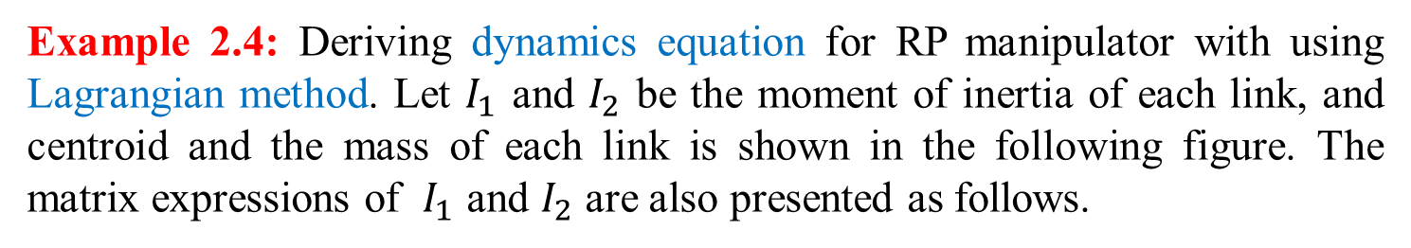
2.3 Properties of Dynamic Model
Example 2.4: Deriving dynamics equation for RP manipulator with using Lagrangian method. Let $I_{1}$ and $I_{2}$ be the moment of inertia of each link, and centroid and the mass of each link is shown in the following figure. The matrix expressions of $I_{1}$ and $I_{2}$ are also presented as follows.
- 14 -

Slide 16
2.3 Properties of Dynamic Model
Firstly, we can obtain the Kinetic Energy of link 1 and link 2, respectively:
Then, the Kinetic Energy of system can be obtained:
Secondly, the Potential Energy of each link can also be obtained:
Therefore, the Potential Energy of system is shown as follows:
Considering the motion equation of the robot can be shown as:
- 15 -

Slide 17
2.3 Properties of Dynamic Model
After conducting the derivative process for
We shall obtain the expression of , and
,
,
Finally, substituting , and into , we can obtain that
- 16 -

Slide 18
2.3 Properties of Dynamic Model
Tutorial
Linear-in-the-parameter (LIP) form?
Let , find
such that
where

Slide 19
2.3 Properties of Dynamic Model
Step1: Decomposing the above equation

Slide 20
2.3 Properties of Dynamic Model
Step2: Establishing the LIP model

Slide 21
2.3 Properties of Dynamic Model
Appendixes: Remarks
Model building of the robot dynamics is essential for numerical simulation, and control system design.
General coordinates, forces/torques of robots, joint velocities, and kinetic and potential energies are key concepts in modeling of robot dynamics.
Typical dynamic equations of robots in joint space is given as follows:
Properties of the robotic dynamics are significant for control system design.

Slide 22
2.3.1 Cartesian Space Dynamics
Cartesian Space Dynamics
The joint space dynamics is given by
It is desirable to express the dynamics of robots in Cartesian space or task space variables rather than in joint space variables q since the tasks of robotic manipulators are often expressed in Cartesian space.
For simplicity, only non-redundant robots are considered here.

Slide 23
2.3.1 Cartesian Space Dynamics
Let , with r and θ being the position and orientation in the base frame. According to forward kinematics, x can be expressed as a non-linear function of q as x = h(q).
Differentiating twice yields
where the Jacobian matrix is

Slide 24
2.3.1 Cartesian Space Dynamics
Assuming that the robot manipulator is away from the workspace singularities, i.e. and exists. Then we have
which is the “inverse acceleration” transformation.

Slide 25
2.3.1 Cartesian Space Dynamics
Thus, the Cartesian dynamics of robots is obtained as
Recall that , where F is the Cartesian force vector
where

Slide 26
2.3.1 Cartesian Space Dynamics
Note: All the properties listed for the joint space dynamics carry over to the Cartesian dynamics as long as is nonsingular.
is symmetric and positive definite
is skew-symmetric
Show the identity: , and try to show the property using the identity.

Slide 27
2.3.1 Cartesian Space Dynamics
The Property of linear in the parameters holds
where the known Cartesian function is
and is the vector of arm parameters.
where are known constants.
, etc

Slide 28
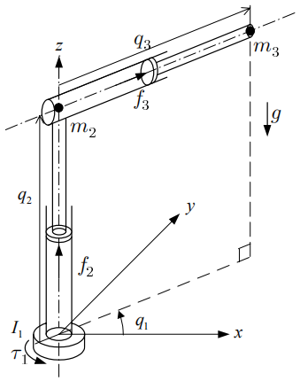
2.3.1 Cartesian Space Dynamics
Appendix 2.4: Three-link Robot in 3D Space
The position of the end-effector is then given by
The Jacobian matrix

Slide 29
2.3.1 Cartesian Space Dynamics
The joint space dynamic equations can be obtained as
where

Slide 30
2.3.1 Cartesian Space Dynamics
The Cartesian space dynamic equations can be obtained as
where
with

Slide 31
2.3.1 Cartesian Space Dynamics
Appendix 2.5: Robot Dynamics in Two Spaces
Joint Space
Cartesian Space
---Cartesian position and orientation vector of the end-effector
---force-torque vector acting on the end-effector
This model is useful for force controller design.

Slide 32
2.3.1 Cartesian Space Dynamics
Appendix 2.6: Inclusion of Friction Effects
Joint Space
Cartesian Space

Slide 33
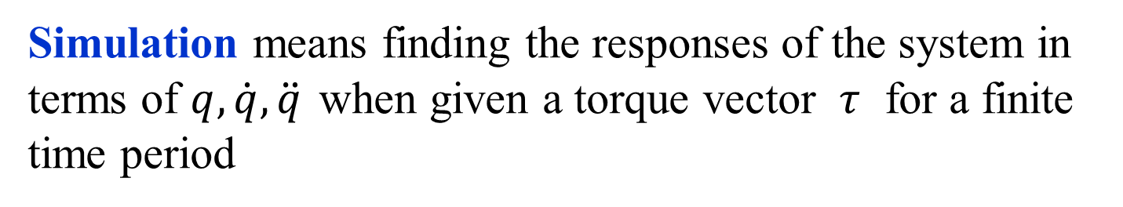
2.3.2 Dynamic Simulation
Appendix 2.7: Dynamic Simulation
.
In terms of mathematics, it means numerical solutions for a set of differential equations.
For the dynamic equations:
We have
Simulation means finding the responses of the system in
terms of $q,\dot{q},\ddot{q}$ when given a torque vector $τ$ for a finite
time period

Slide 34
2.3.2 Dynamic Simulation
There are two methods:
Simple Integration Method
Given initial conditions , , we have
2) General Numerical Solution
Define , then it shall be obtained that

Slide 35
2.3.2 Dynamic Simulation
There are two methods:
Simple Integration Method
Given initial conditions , , we have
2) General Numerical Solution
Define , then it shall be obtained that

Slide 36
2.4 Dynamic Tutorials
Derive the dynamics for the robot shown in Fig.1 using any method that you are comfortable with and compare.
Displacements: and
Forces: and
Masses: and
Fig.1

Slide 37
2.4 Dynamic Tutorials
2. Suppose the robot is under the influence of gravitational acceleration. Assume the mass of each link is lumped at end of the link. Under the assumption of lumped equivalent masses, derive the Dynamic equation using any method you feel comfortable with.
Fig. 2

Slide 38
2.4 Dynamic Tutorials
Hint:
Find the positions and velocities of and with respect to the base xyz
b) Find the kinetic energy K and the potential energy V
Find the expression for matrix from
Find the Lagrange-Euler Equations
where

Slide 39
2.4 Dynamic Tutorials
3. Suppose that the robot is under the influence of gravitational acceleration. Assume the mass of each link is lumped at the centre of the link. r_{i} denotes the distance from joint i to the centre of mass of link, and l_{i} denotes the length of link i. Under the assumption of lumped equivalent masses, derive the Dynamic equation using any method you feel comfortable with.
Fig. 3

Slide 40
2.4 Dynamic Tutorials
4. Consider the 2 link robot in 3D space, assume that the mass of each link is lumped at end of the link.
i) Under the assumption of lumped equivalent masses, derive the
dynamics of equation.
ii) Is there any possible configurations for 2 link robots?
iii) Can you image the complexity of higher degree of freedom robots?
Fig. 4

Slide 41
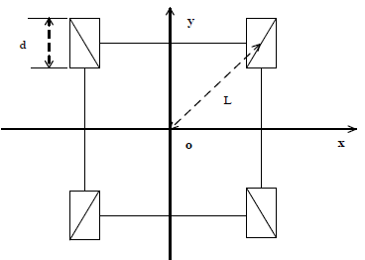





2.4.1 Dynamic Tutorials: Problem
5. For the differential driven wheeled robot shown in Figure 5, where each wheel is driven independently. Forward/backward motion is produced by driving both wheels at the same rate, and turning right/left is achieved by driving the wheels at different rates.
$$ω_{1}$$
$$ω_{2}$$
(i) Give two different sets of generalized coordinates for the robot, and clearly indicate the type of joints.
$$ω$$
$$ω_{3}$$
$$ω_{4}$$
Fig. 5
(ii) Find its kinetic energy, and Langrange-Euler equations.

Slide 42
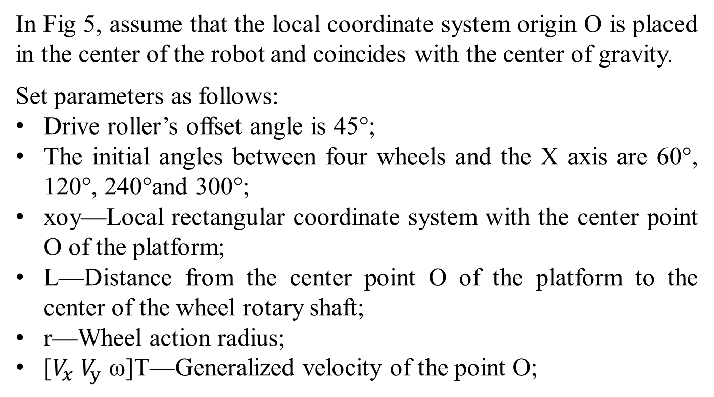
2.4.1 Dynamic Tutorials: Problem
In Fig 5, assume that the local coordinate system origin O is placed in the center of the robot and coincides with the center of gravity.
Set parameters as follows:
Drive roller’s offset angle is 45°;
The initial angles between four wheels and the X axis are 60°, 120°, 240°and 300°;
xoy—Local rectangular coordinate system with the center point O of the platform;
L—Distance from the center point O of the platform to the center of the wheel rotary shaft;
r—Wheel action radius;
[$V_{x}$ $V_{y}$ ω]T—Generalized velocity of the point O;

